Slide 1
CUSTOMER CHURN PREDICTION
A Data Science Approach
IAN NZANGI
1 JUNE 2024

Slide 2
Project Overview
Objective: Predict customer churn using machine learning.
Methodology: Data preprocessing, exploratory data analysis, feature engineering, model training and evaluation.

Slide 3
Data Description
SyriaTel Dataset (3,333 rows, 21 columns)
Key features: Account length, area code, international plan, etc.
Target variable: Churn status.
Notes:
Purpose: Understand data distribution and relationships.Key findings and initial insight

Slide 4
VISUALIZATIONS

Slide 5
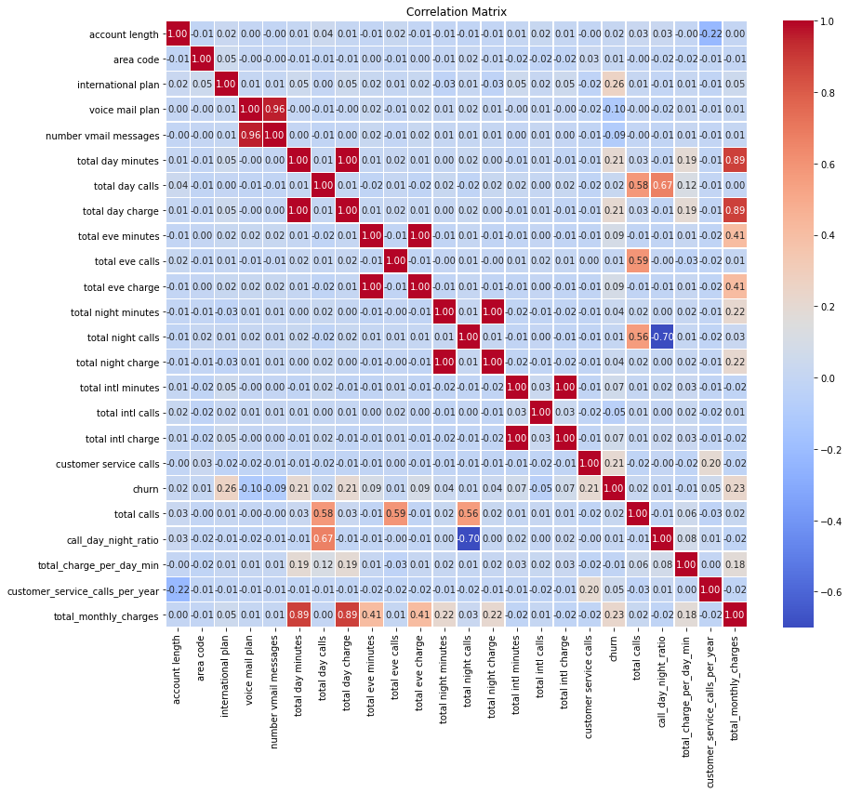
Corelation heatmap

Slide 6
Observation: High correlations (e.g., total monthly charges vs total day minutes).

Slide 7
Boxplots
Boxplots for customer service calls and total monthly charges

Slide 8
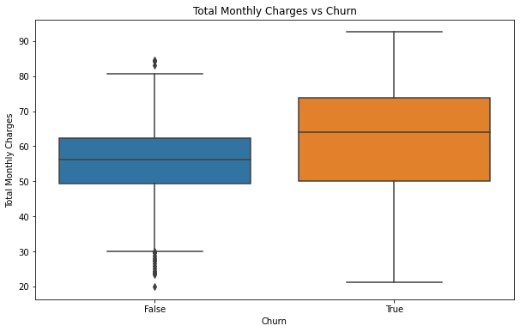
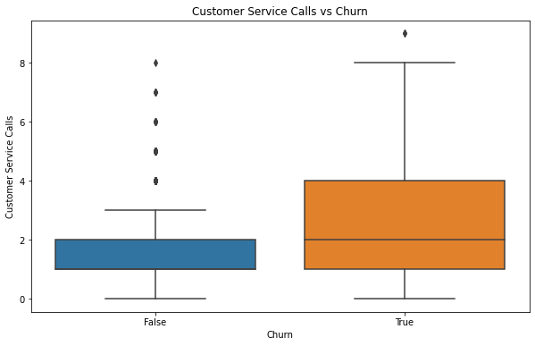

Slide 9
observations
Higher values in these features are associated with higher churn rates.

Slide 10
Baseline Model (Logistic Regression)
Accuracy: 84.9%
Precision: 0.0
Recall: 0.0
F1 Score: 0.0
ROC AUC Score: 0.5
Conclusion- Decent accuracy but poor precision, recall, and F1 score.

Slide 11
Decision Tree Classifier
Accuracy: 93.7%
Precision: 76.1%
Recall: 85.1%
F1 Score: 80.4%
ROC AUC Score: 90.2
Conclusion- Improved performance over baseline model.

Slide 12
Model Evaluation
Decision tree shows significant improvement in performance.

Slide 13
recommendations for Real-World Problem
Decision tree classifier recommended for predicting customer churn.
Enhance the services and features in the $45 to $65 range to ensure continued satisfaction and value perception.
Invest in improving service quality to reduce the need for customer service interactions and enhance overall customer satisfaction.

Slide 14
Thank you!
Ian nzangi
iannzangi@student.moringaschool.com

